Slide 1

Human Resources The Right Way!!

Slide 2

We are:
We are all third-year students programmers for
Software Engineering in JCE.
NICE TO MEET YOU ☺

Slide 3

The main idea
MadeInJLM wanted to change the concept of human resources in Jerusalem, we did it together!
We worked on the company side, building an interface to allow them to view and choose from a repository of awesome students

Slide 4
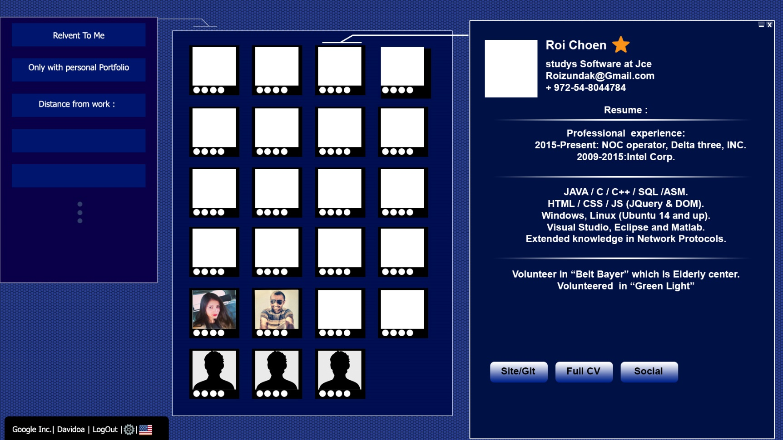
FIRST DESIGEN

Slide 5

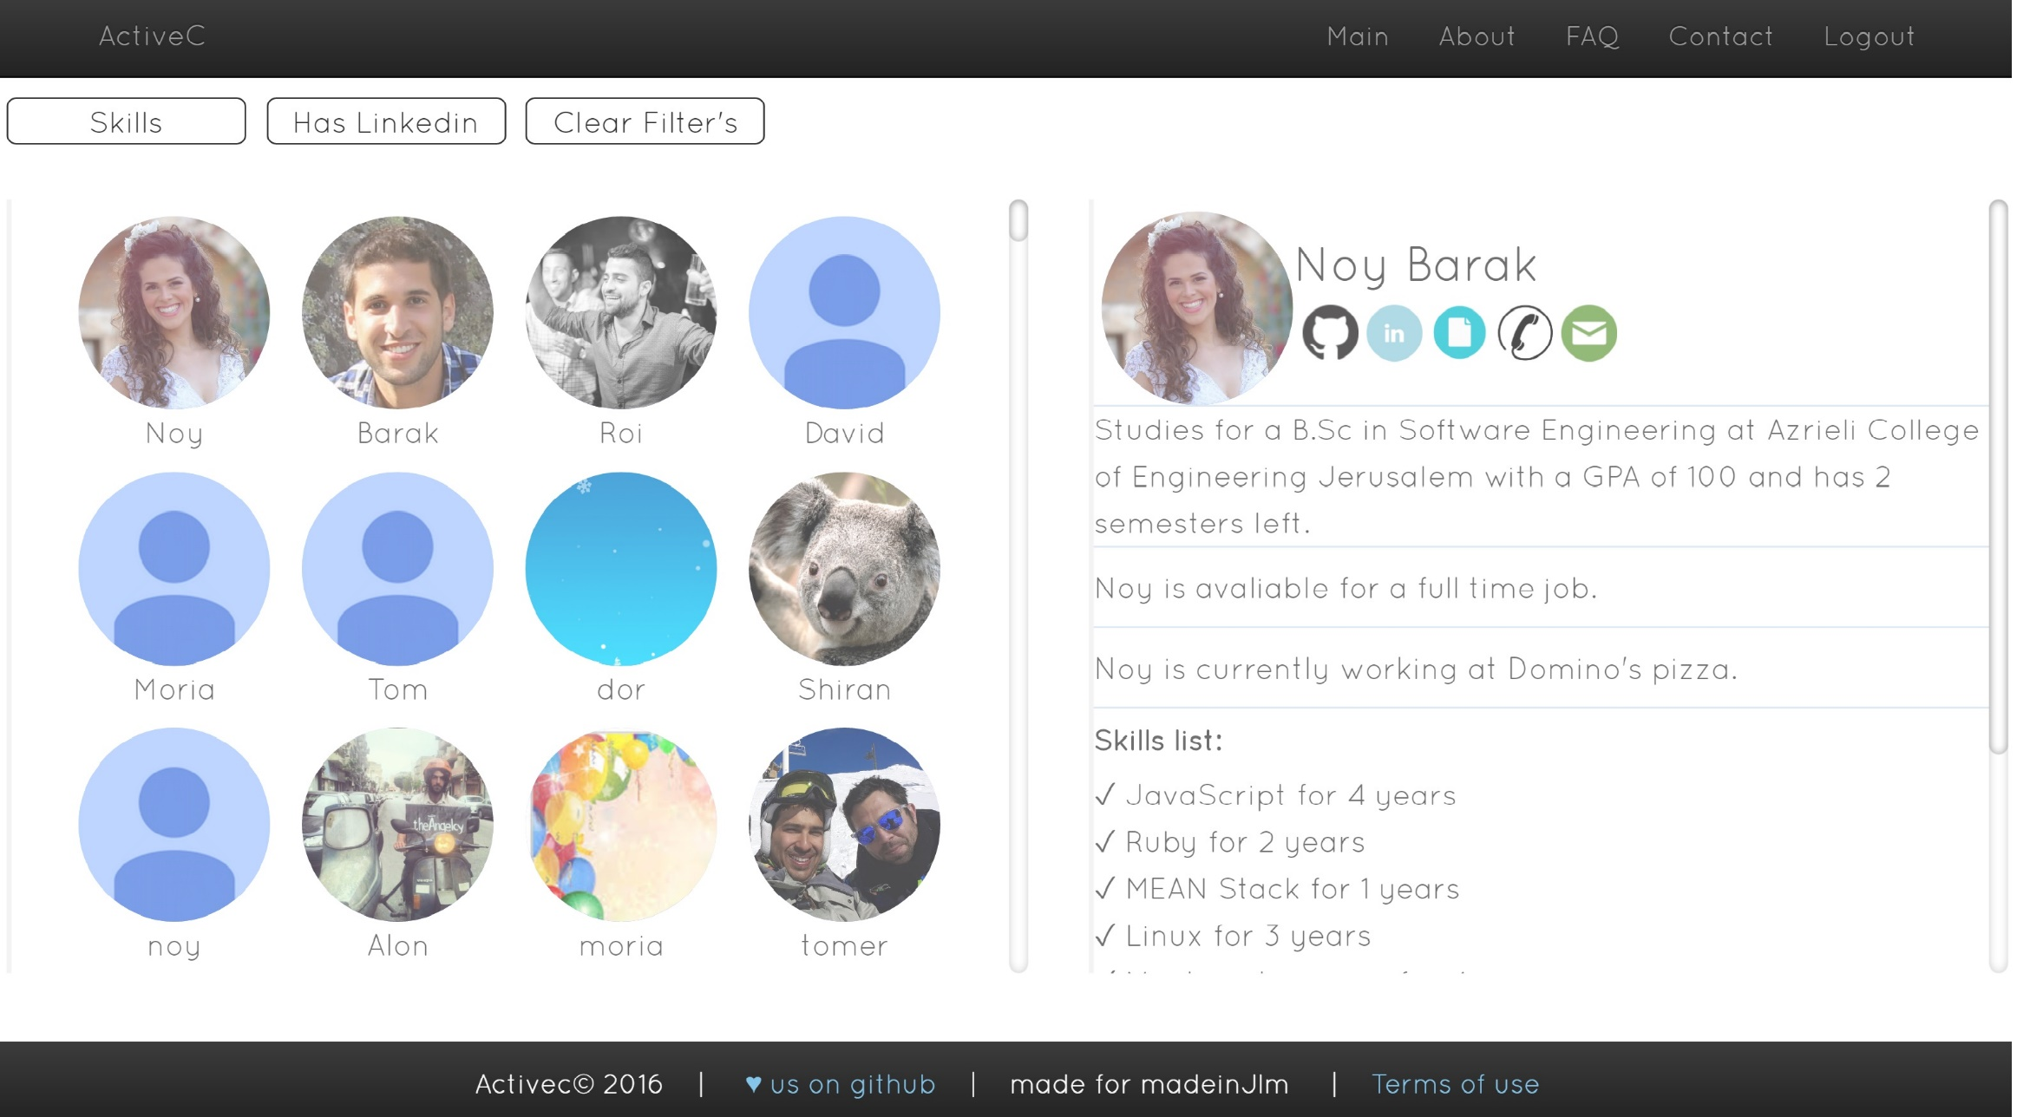
And nowww….

Slide 6
And finally thank to the masters
To MadeInJLM and their awesome contact Tom Wininger.
To the course staff : DR. Reuven Yagel, Itamar Sharifi and Ziv Moraly
To the other taem
To our great T-E-A-M

